Slide 1


Data Science PROJECT TELECOM CHURN PREDICTION PROJECT TEAM ID - PTID-CDA-NOV-24-246 PRESENTED BY: ANUPRIYA S R ANJALI M K PRATHAM P M

Slide 2
Agenda
1. Introduction
2. Business Case
3. Dataset Overview
4. Data Preparation
5. Modeling and Results
6. Recommendations and Insights

Slide 3
INTRODUCTION
Objective
No-Churn Telecom aims to leverage Machine Learning to address the challenge of customer churn in a competitive telecom industry.
PROJECT GOALS:
1. Understanding the variables that are influencing the customers to migrate.
2. Creating Churn risk scores that can be indicative to drive retention campaigns.
3. Introduce new predicting variable “CHURN-FLAG” with values YES(1) or NO(0) so that email campaigns with lucrative offers can be targeted to Churn YES customers.

Slide 4

BUSINESS CASE
No-Churn Telecom is an established Telecom operator in Europe with more than a decade in Business. Due to new players in the market, telecom industry has become very competitive and retaining customers becoming a challenge.
In spite of No-Churn initiatives of reducing tariffs and promoting more offers, the churn rate ( percentage of customers migrating to competitors) is well above 10%.
No-Churn wants to explore possibility of Machine Learning to help with following use cases to retain competitive edge in the industry.

Slide 5
Dataset Overview
Source: SQL database with 4,617 records.
Features:
- Customer Demographics: State, Area Code, Phone Number.
- Service Usage: Day Mins, Night Calls, International Plan.
- Customer Support: Number of Customer Service Calls.
Target Variable:
- 'Churn' (Yes/No).

Slide 6

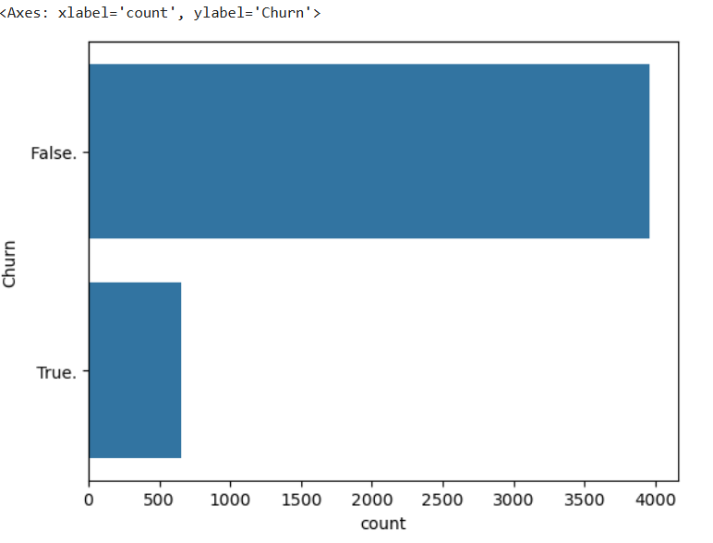

Slide 7

Data Preparation
Steps Taken:
1. Data Cleaning:
- Handled missing values and inconsistent data entries.
2. Feature Engineering:
- Created a new 'Churn-Flag' variable.
3. Data Transformation:
- Normalized numerical features.
- Encoded categorical variables.

Slide 8
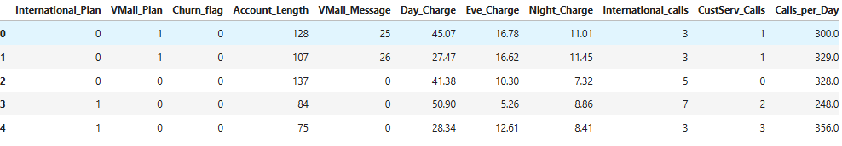
Churn Flag

Slide 9
Modeling and Results
Models Used:
- Logistic Regression
- Random Forest
- Gradient Boosting and etc…
Key Metrics:
- Accuracy, Precision, Recall, F1 Score.
Feature Importance:
- Highlighted top predictors of churn (e.g., Customer Support Calls).

Slide 10

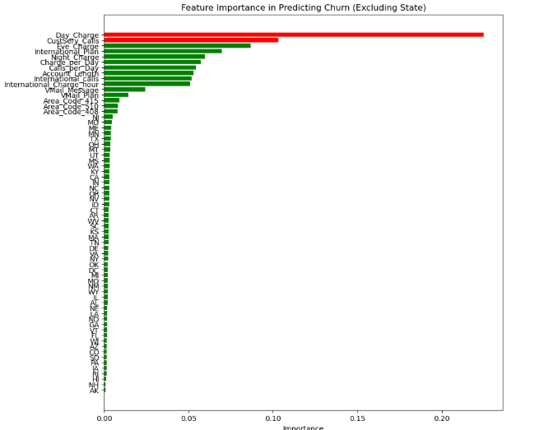
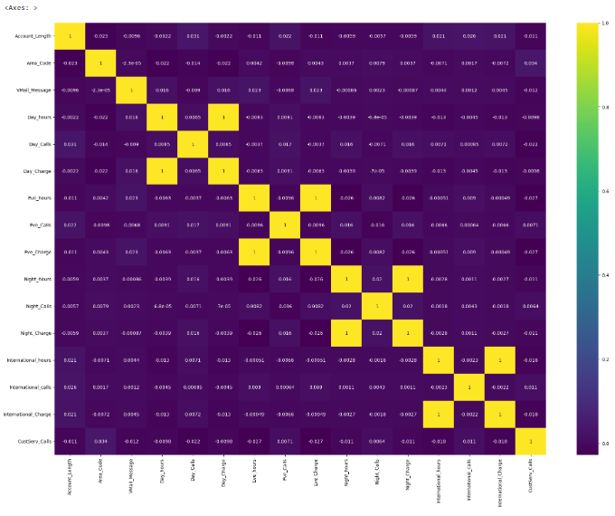

Slide 11
Conclusion
This churn prediction model provides No-Churn Telecom with actionable insights by identifying key churn drivers and providing churn risk scores for each customer.
The high accuracy of the Random Forest and XGBoost models will allow the company to focus its retention strategies on customers with the highest likelihood of churning,
ultimately improving customer retention and reducing churn rates.

Slide 12

Thank you

